Slide 1
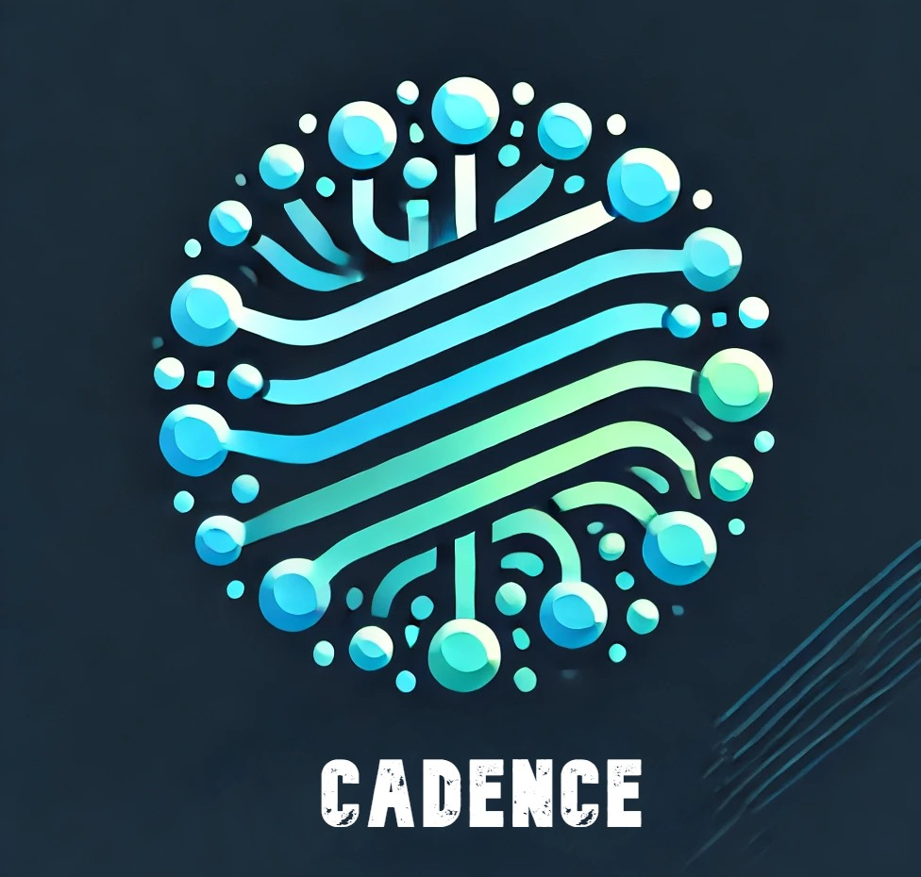
Cadence
AI-powered Clustered Content Platform
- MonaD.AI

Slide 2

Agenda
Overview
Problem Statement
Solution : Cadence
Business Use-case & Target Audience
Technical Architecture/Working Flow
AzureAI Implementation
Figma Designs/ Imaginations
Conclusion

Slide 3

Problem Statement
Posting Challenges on LinkedIn/Instagram ?
Profiles often become cluttered, making it hard to find relevant content. Users need a way to track challenges and streaks efficiently while keeping their content organized.

Slide 4

Solution : CADENCE
Clustered content organization platform
Simple and automated posting
Track challenges & streaks within clusters

Slide 5

Areas of focus
Target Audience
Business Use-cases
Individuals taking challenges (like 75 Hard or journaling)
Habit builders and streak makers
Productivity enthusiasts
People tracking progress across multiple domains
Integration to 3rd party applications like LinkedIn, Notion, Trello for increased productivity

Slide 6

Productivity
Trigger alerts for missed updates or milestones achieved.
Gamification potential with rewards for streak completion.
Emphasis on curating a well-structured post as well as profile.

Slide 7
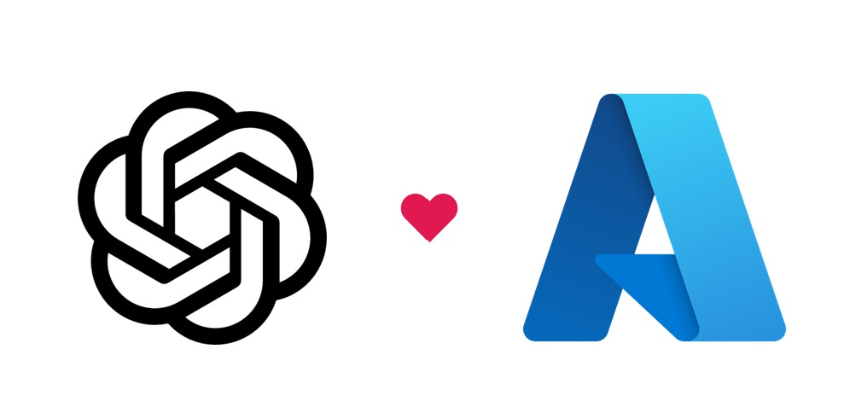


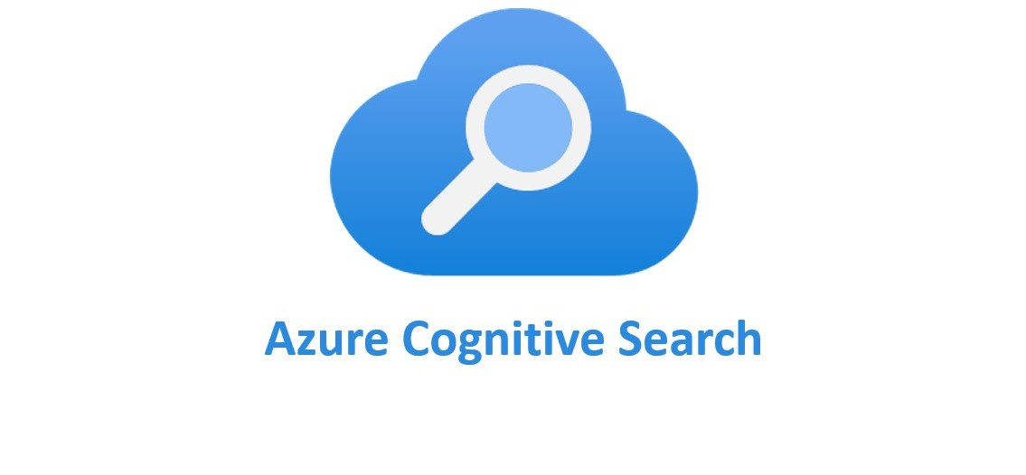


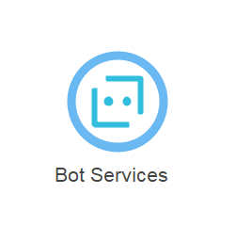

Incorporated AzureAI services
Azure OpenAI
Azure Functions
Azure Blob Storage
Azure Cognitive Search
Language Studio
Computer Vision
Bot Services
Notification Hub

Slide 8
Cadence's Working Flow
Configure the Challenge/Streak
Blob Storage
Integrating & Implementing AI
Curating a post & analysis
Tadaa!! or Ohh! Missed the streak -> Gets alerted!

Slide 9
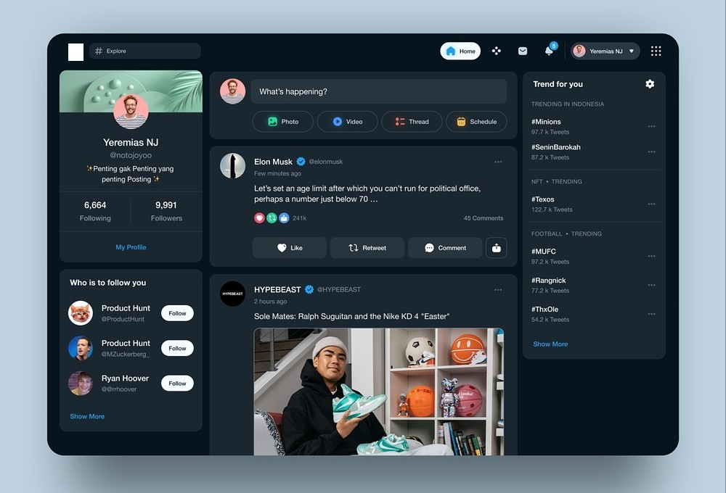
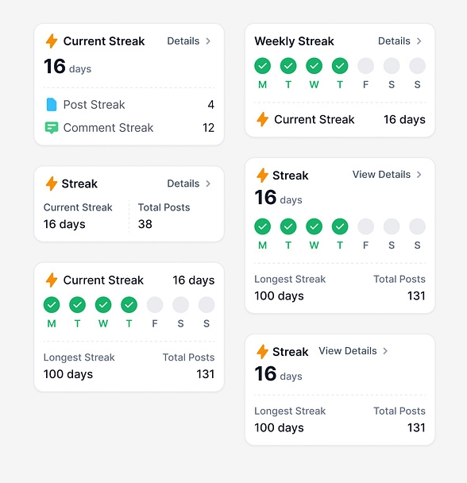
Imagination of Cadence
Dashboard
Streaks

Slide 10
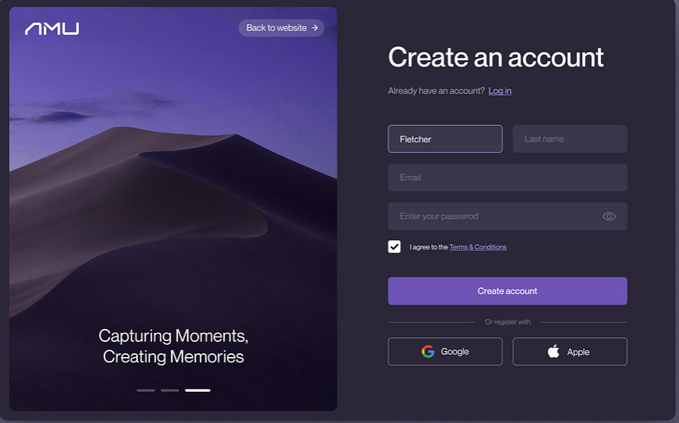
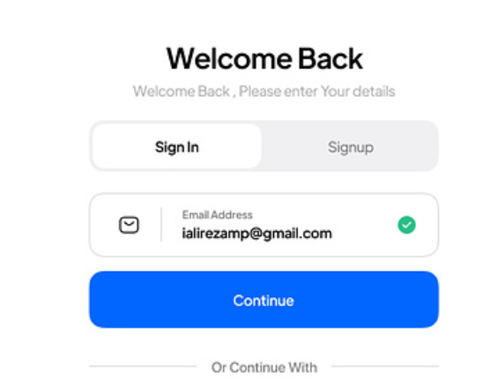
Imagination of Cadence
Registration
Login

Slide 11

Closing remarks
Cadence is more than just a platform for organizing challenges—it’s a tool for building consistency, managing progress, and staying motivated. With the integration of Azure AI services, it offers powerful personalization, search capabilities, and automation, making it the perfect solution for individuals, teams for long-term success.
Questions are Welcomed! :)

Slide 12

Thank you
MonaD.AI
cadence@monad.com
cadence.monad.ai

